Slide 1

NỘI DUNG TRÌNH BÀY
Giới thiệu chung
Mô hình sử dụng
Giải pháp
Đề xuất mô hình học tập mới

Slide 2
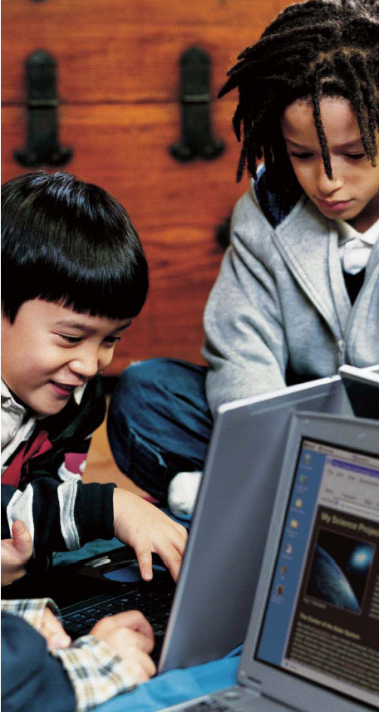




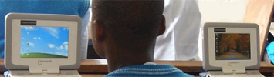
CMPC – MÔ HÌNH HỌC TẬP MỚI

Slide 3
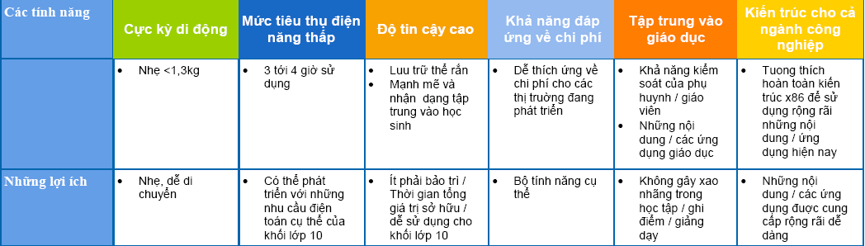
TÍNH NĂNG CỦA CLASSMATE PC

Slide 4
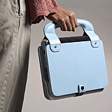
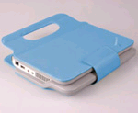
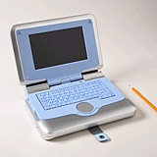
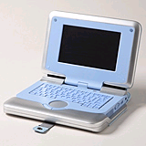
MÔ HÌNH SỬ DỤNG VỚI CMPC

Slide 5

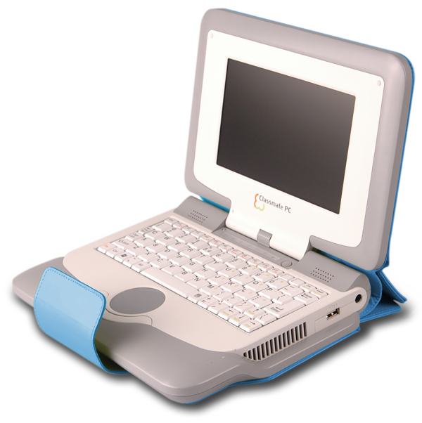



GIẢI PHÁP CLASSMATE PC
CHO GIÁO DỤC
40 CMPC
Teacher
Recharging rack
Notes:
[Primary call-to-action: this is it!]
Make it happen!
Let’s work together, starting now.
[And remember that solution blueprints, technical documents, success stories, and other helpful how-to documents are available on SSCC and on your Sales Kit CD-ROM.]
[intel.com/go/education is Intel’s public Web site focused on SALES. It includes a summary of our sales story, the latest marketing material, and links to key Intel product and other education sites. This is the main site to send customers to. It was refreshed in April 2006 to correspond to the launch of this campaign (“Building the Future on Knowledge”.)]
[K-12blueprint.com is the U.S.-specific site focused on 1:1 eLearning, and paid for by Intel and the Center for Digital Education. Excellent resource for 1:1 eLearning public information: blueprints, white papers, etc.]
[Intel.com/education is the Intel site focused on philanthropic (non-sales) education activities. It is run by the Intel® Education initiative (formerly known as Intel® Innovation in Education). Go here for information about Intel’s tools, resources, and programs that support education worldwide.]

Slide 6
GIẢI PHÁP CLASSMATE PC
CHO GIÁO DỤC
Giải pháp CMPC áp dụng đồng bộ trong trường học
  Software
Optional | NoteTaker | Học sinh có thể sử dụng bút cảm ứng để vẽ, phác họa, hoặc ghi chú và có thể lưu lại trong máy.
Intel exclusive | Special Graphics Driver | Học sinh có thể khoanh tròn các nội dung chính trong quá trình xem nhanh một nội dung quá dài.
Intel enhanced | Teacher Control | Giáo viên có thể giảng bài, điều khiển quá trình hoạt động, làm việc nhóm của học viên để giúp học viên hiểu bài hơn.
Intel enhanced | Parental Control | Giáo viên và phụ huynh có thể hướng dẫn học viên cách dùng các ứng dụng để tham khảo nội dung trên internet.
Intel exclusive | Theft Control | Từng trường sẽ quản lý được giáo án, phần mềm dạy học, bài học sinh… của riêng trường để tránh tình trạng thất thoát số liệu.

Slide 7
e-Learning Class Software
Classroom management
Notes:
Classroom Management: – The e-Learning Class software enables a teacher to manage the classroom, communicate with students, and assist individuals. The e-Learning Class Software, provides the following highlights: –
Broadcast desktop and voice to students’ devices
Monitor and take control of students’ devices, including usage restriction of student keyboards and mice, as well as screen blanking
Stream video content to students’ devices
Record desktop operations to a file and play them back
Remotely shut down students' devices
Send files to students’ devices
Send messages to students’ devices
Send remote command to students’ devices
Prepare and distribute interactive quizzes

Slide 8






eLearning Các thành phần
Số hóa chương trình giảng dạy
Cải thiện phương pháp học tập
Phát triển chuyên môn
Công nghệ
Digital Curriculum
Improved Learning Methods
Kết nối
Professional Development
Connectivity
Technology

Slide 9
eLearning Environments
1:1 eLearning
Classroom eLearning
Learning Value
Tích hợp kỹ thuật số hoàn toàn vào chương trình giảng dạy
PC Labs
Một số chương trình giảng dạy tích hợp kỹ thuật số
Lấy học sinh làm trọng tâm của học tập
Basic ICT
Học trên máy chiếu
Tập trung trên máy tính học tập
Học sinh hiểu được sâu sắc kiếm thức được chuyền thụ
Học tập theo nhóm
Kiến thức được tìm hiểu sâu hơn, rộng hơn
kỹ thuật số chương trình giảng dạy
Chỉ chia sẻ thông tin
Broad, fast coverage (WiFi, WiMAX)
Cải thiện phương pháp học tập
Wireless in classroom
Phát triển chuyên môn
Wired, lab only
Kết nối
Dialup
Laptops (1:1)
> 25:1
~ 10:1
Computers-on-wheels or shared desktops
(~ 5:1)
Công nghệ
Notes:
Successful education strategies include an increasing use of these key ingredients working together
As the number of computers per student increases, computers become mobile (laptops, tablets, handhelds) and connectivity increases, one shifts from basic ICT and PC lab environments to true eLearning environments
Let’s focus on 1:1 eLearning and classroom eLearning – these are the optimal eLearning environments where you can really begin to develop 21st century skills
[transition]
The 1:1 eLearning model – where each teacher and student has a dedicated laptop computer – is seen by many as the ideal way to integrate technology in the curriculum and maximize its benefits.

Slide 10



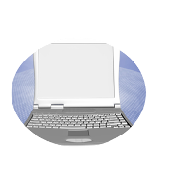
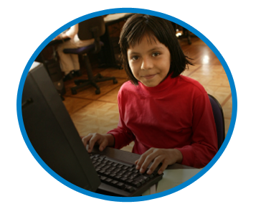
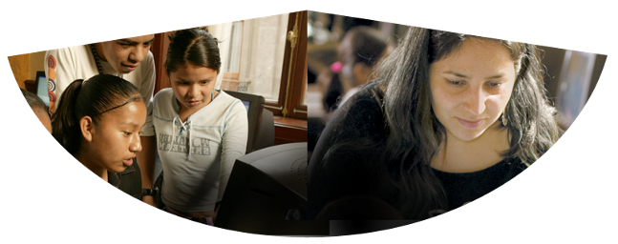
Student-Centered Learning
Chuyên gia
Thư viện
Trường học
Các trung tâm giáo dục
Các tổ chức khác
Internet
Học sinh
Chia sẻ nhóm
Hướng dẫn
Notes:
Integrating technology in to the classroom and the core curriculum is a paradigm shift from an instructor-centric learning experience (lecture-driven, knowledge acquisition) to one which is student-centric. In an instructor-centric paradigm, the student is dependent on the instructor for information, direction, and guidance. (student-directed, knowledge creation)
In the student-centric paradigm, students increasingly become independent, self-directed learners who master higher-level critical thinking, problem-solving, and collaborative skills. Students learn at their own pace, repeating material to reinforce learning, or delving into additional material to enrich it. ITC makes this type of learning possible.
Other key attributes of integrating technology into the classroom environment include:
Computing is ubiquitous and mobile – anytime, anywhere learning as opposed to stationary PC labs
Computing integrated into the curriculum – computing is a tool for learning as opposed to a subject in itself
Learning is collaborative and connected – students more easily work with peers, teachers and community experts; teacher more easily work with peers and parents
Computing becomes personalized and moves towards a ratio of one PC per student and teacher

Slide 11
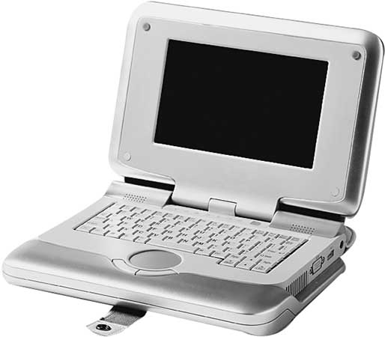
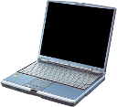
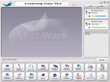
Classroom Collaboration SW
Giáo viên (Quản trị)
Máy tính học sinh
Đánh giá thông qua kiểm xoát trực tuyến
Gửi hình ảnh, tin nhắn, ..
Khóa/bật máy thành viên
Đồng bộ màn hình cả lớp theo giáo viên
Enables collaborative learning
Shares tasks and activities
Shares learning experience
All through a wireless network environment!

Slide 12
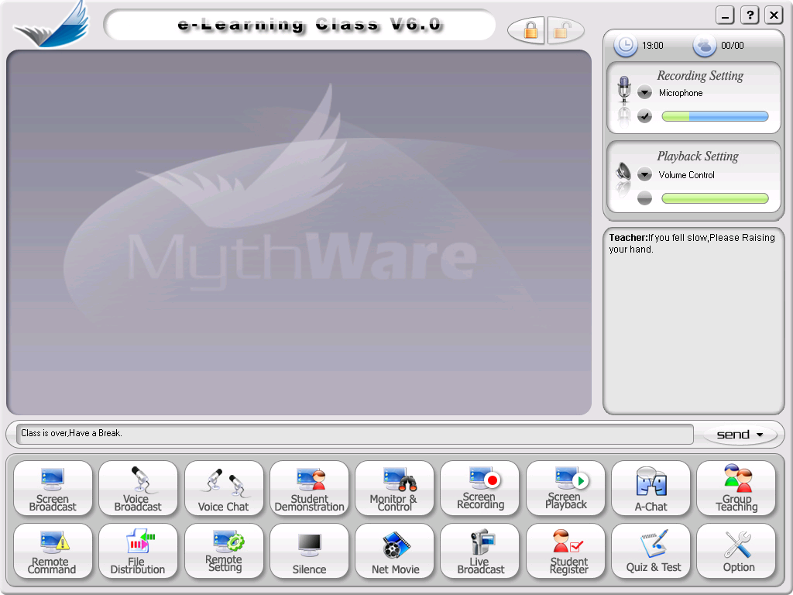
E-learning Class – Teacher console
Clock and number of connected students
Visual console
Microphone and Speaker settings
Text messaging
Send Remote Message
Function Bars
Notes:
The teacher console is a dashboard control system for the teacher to manage the class. The e-Learning Class software is divided into the following five different parts:
Title Bar
Main Screen (Class Model)
Remote Message
Microphone and Speaker Settings
Function Bar
Remote Message
With Remote Message, a teacher can send text messages to students and receive messages from students. Furthermore notifications can be received when the following events occur: a student logs in, a student logs out, a student submits files, a student sends messages, a student raises a hand for help, and so on..
To send a text message to a student:
Enter the message in the edit control below the Class Model area.
Click the Send button.
Tips: Click the down arrow on the right side of the Send button, and a list of common phrases will appear which can be selected to send.
Microphone and Speaker Settings
Microphone and Speaker Settings volume control of the E-Learning Class software. With the settings, the teacher can adjust the recording or playback volume.
To adjust recording or playback volume:
Click the down-arrow button to select the recording or playback source from the drop-down menu.
Click the volume bar to adjust volume.
To select the recording source:
Click the down-arrow buttons to select the recording source from the drop-down menu.
Click the checkmark button below the down-arrow button . If the source has been selected, the checkmark button will be checked.
To mute the playback destination:
Click the down-arrow button to select the playback source from drop-down menu.
Click the checkmark button below the down-arrow . If the destination has been muted, the button will appear as the following: .
Function Bar
The Function Bar contains two rows of icons, which include the most commonly used functions for the teacher. Each icon indicates a different function.
To start a function, click on the function’s icon.
To stop the function that is running, click the same icon again and the function will stop running.
Each function icon has four states:
Normal state: function is ready; nothing has happened
Hot state: the pointer is on the icon
Down state: the icon has been clicked
Disable sate: the function is disabled

Slide 13

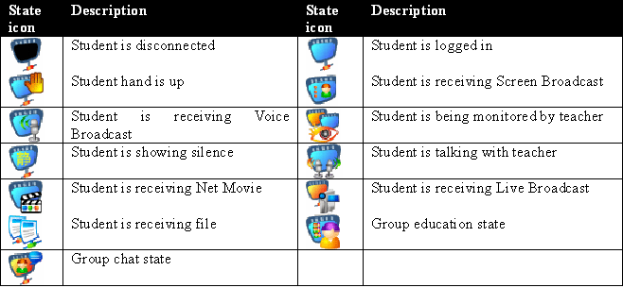
Student states
Notes:
The Main Screen – known as the “Class Model” displays student device icons to indicate the number of students who are logged in, and the different states of those students. Each student icon has its own set of property information.
The Student Property feature provides each student summary information for the teacher. The summary information includes: computer name, IP address, MAC address, operating system name and version, CPU speed and memory size, and any applications and processes that are running the student device.
To view a student’s property information:
Right-click on a student icon.
Click the Information tab, Application tab, or Process tab to view different properties.
To terminate a student’s applications or processes that are running:
Right-click on a student icon.
Select the Application tab or Process tab of the proper sheet.
Select an application or process.
Click the close icon at the top of the application or process list control.
Selecting Students
Before starting each function of the e-Learning Class software, the teacher should select which students’ computers will be connected. The teacher can select one student, multiple students, or all the students in a class.
To select one student, click on the student’s icon.
To select multiple students, hold down the left ctrl key and click on each student’s icon one by one.
To select all students in a class, click on the blank space of the Class Model area to deselect students’ icons.
Tips: If no student’s icons are selected, that indicates that all the students in a class will be connected to a Class Model.
Add Student to Class Model
Teachers can add students to a Class Model by two methods, one is manually, and the other is by accepting a request.
To add a student manually:
Right-click in a blank space of the Class Model window.
From the popup menu, select class model >Add student.
Enter the MAC address and student name of the student’s computer, and then click OK.
Tips: The e-Learning Class software uses the MAC address of a student’s network adapter as the student’s unique ID.
To add a student by accepting a request:
A student attempts to connect to the teacher computer.
If the student has not been added to a Class Model, a waiting list dialog box will appear on the teacher screen. The waiting list dialog box lists all the students who are connecting to the teacher computer.
Select the student from the list, and then click Accept.
The student is added to the Class Model and logged in after a short time.

Slide 14
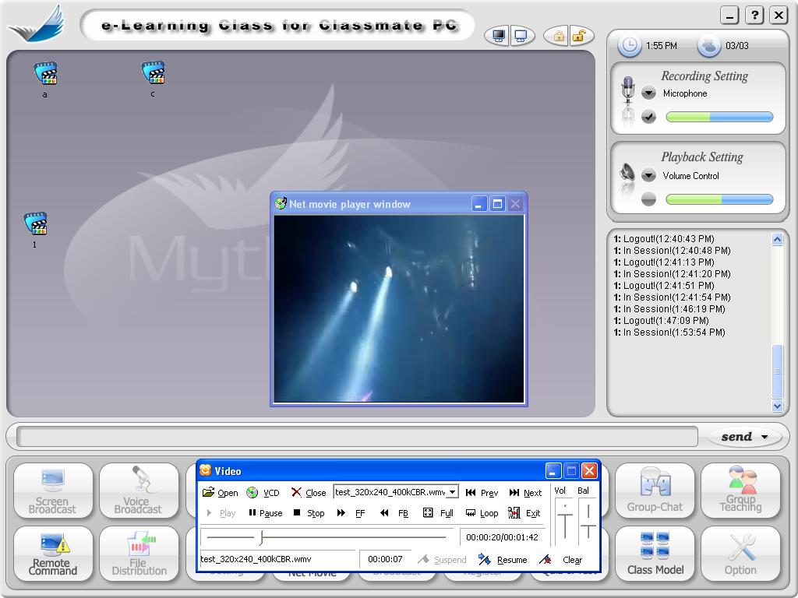
Operate Teacher Control
Net Movie
If you want to suspend net movie, you could press the “Suspend” button, there will note the suspend time.
The suspend time would keep until you to press “Clear” button to clear it.
If you want to start net movie at the suspend time, you could press “Resume” button.
Clear the suspended setting
Suspended time
Resume net movie
Suspend net movie
Net Movie Finished
Note: You can only suspend 1 net movie at most.

Slide 15
Beginning of the lesson: connecting the pupils
Teacher must first establish connection
Students will see a list of teachers to connect to
Students will select the appropriate teacher to connect o
Students may elect to provide a nick name
The teacher will see a list of the connected students, and is able to approve / reject a student connection
Lock Session: The student devices remain connected to the teacher device, persisting through network interuptions, until the teacher manually disengages the student devices
Show the student screen, so that teacher know what is
happening at the other end
Move this screen ahead of the Student screen state
Notes:
At the beginning of each class, the teacher must establish the teacher device as a host for students to connect their devices to it.
The students will see a list of teacher devices as session hosts, and will elect to connect to one of the sessions.
The teacher will be notified who has connected to the teacher session. At any time, the teacher may reject a student from connecting to the session for any reason, such as a student having erred by having chosen the wrong class / teacher to connect to.
After logging in to the system, the teacher’s name will be displayed on the network and students will be able to find it on their desktops. Sometimes a student may find multiple teachers on the network, and will be able to select one to join the class. If the students in the Class Model are required to join the class session, the Lock feature can enforce this request.

Slide 16


Lock student devices to e-Learning
Persistant across network failures
Student devices will automatically reconnect to existing session upon network connectivity resumption
Upon the end of a teacher session, all student devices will be automatically unlocked
Notes:
Teachers have the ability to lock student devices to the connected session, despite network disruptions. When a student has established a session with the teacher device, the student device is giving complete autonomy to the teacher. To prevent the student from wilfully or otherwise disengaging the student device from the session, the lock mechanism enables the teacher to maintain session control once the student device has established network connectivity. If the lock mechanism is not enforced, then the student has the option to disengage the student device at any time, and not force the student device to maintain a connected session to the teacher device. Unlocking the session is necessary to release the student devices to operate freely once the class has ended.
To lock all students, click the left-hand button on the Title Bar, or right click on the blank space in the Class Model area and select Lock all student in the popup menu.
After the lock has been set, all students in the Class Model will automatically connect to the session. Once they are connected, they cannot disconnect again unless they are unlocked.
Tips: When the teacher exits the class, all locked students will be unlocked automatically.
To unlock all students, click the right-hand button on Title Bar.
Tips: Once a student is unlocked, (s)he can select the student’s icon and select the remove command from the popup menu. Then the student can be removed from the teacher’s Class Model and log out.

Slide 17

Command buttons
Monitor a student device by viewing its screen
Redirects a student screen to other student devices
Voice conference
Broadcast voice audio from teacher device to student devices
Broadcast teacher’s screen to student devices
Notes:
The Function Bar contains two rows of icons, which include the most commonly used functions for the teacher. Each icon indicates a different function.
There are several buttons, each representing a command, that the teacher may use to enhance class instruction.
Screen Broadcast – Projects the teacher desktop to all the student devices. The students will be able to view everything on the teacher device, as if the students were physically located next to the teacher. All the actions such as mouse cursor movements, and applications will be projected.
Voice Broadcast – Projects audio to all student devices.
Voice Chat – Multi-way communication between teacher and student devices.
Student Demonstration – Redirects one of the student device displays to all the other students. Used to allow a particular student to showcase something, such as a drawing, a presentation, or anything that is desired to be shared.
Monitor & Control – Allows a teacher to view a student desktop and all actions associated to it.
Screen Broadcast
Screen Broadcast is one of the most important functions of the e-Learning Class software. The teacher can broadcast the screen to one or more of the students in the class in either Full Screen or Windowed mode. In Full Screen mode, the broadcast fills the students' screens, and they cannot view or use other applications during the broadcast. In Windowed mode, the desktop appears in a window on the students' desktops and they can switch between this window and other applications.
The teacher can also communicate to connected students via microphones, headphones and speakers while broadcasting your screen.
In addition to allowing you to broadcast normal application windows, the e-Learning Class software provides the ability to broadcast the following application windows without disabling DirectDraw acceleration of system:
DirectDraw window
Direct3D window (for example, Cool 3D, AutoCAD, Pro-Engineer, and 3D MAX)
OpenGL window (for example, Quake III)
Full screen movie window (for example, WinDVD Player, and the Windows Media Player)
Start Screen Broadcast
Select students.
Click the “Screen Broadcast” icon on the Function Bar
or
press the combined hot key {Ctrl + Alt + F6}.
Tips: {Ctrl + Alt + F6} is the default hotkey defined by the e-Learning Class software. This can be redefined in the option settings.
The e-Learning Class program will be minimized and will display a floating toolbar at the top of the desktop.
Stop Screen Broadcast
To stop Screen Broadcast:
Click the “Screen Broadcast teaching” icon in the Screen Broadcast floating toolbar.
or
Press the “Break” key.
Tips: the “Break” key is the predefined hotkey to stop the currently running function of the e-Learning Class software. If other functions are performing, then this hotkey can also be used to halt these functions.
Screen Broadcast Floating Toolbar
When starting Screen Broadcast, the e-Learning Class is automatically minimized and a floating toolbar appears at the top of the desktop. The floating toolbar automatically hides itself, and will appear when the mouse cursor is hovered at the top of the desktop.
The Screen Broadcast floating toolbar is designed to help teachers open other tools while broadcasting a screen to students.
With the Screen Broadcast toolbar, the following can be accomplished:
Start and stop broadcasting voice to student
Use the Electronic pen
Record operations to file
Adjust Screen Broadcast picture quality
Switch between Full Screen and Windowed mode
Lock and Unlock a student’s keyboard and mouse
Change Screen Broadcast efficiency
Broadcast Voice to Students while Running Screen Broadcast
The e-Learning Class software allows the teacher to speak to the students during Screen Broadcast. Voice audio can be heard by all students who are receiving the Screen Broadcast.
To start speaking to students, just click on the voice icon from the Screen Broadcast toolbar.
To stop speaking to students, click again on the voice icon of the Screen Broadcast toolbar.
The e-Learning Class software one selected student to speak during Screen Broadcast. The selected student’s voice can be heard both by the teacher and other students who are receiving the Screen Broadcast.
To select one student to speak to, do the following:
Click the “Show/Hide Window” icon on Screen Broadcast toolbar.
Right-click the icon of the student in the Class Model who is receiving the Screen Broadcast.
From the menu, select Begin student’s Talk.
Tips: If the student you selected has begun the talk, the menu item will change to Stop student’s Talk.
Voice Broadcast
The e-Learning Class software provides the ability for audible communications to connected students via microphones, headphones and speakers while running Voice Broadcast. The audio features of the e-Learning Class software can only operate if the workstations have audio hardware.
Start Voice Broadcast
Select the students in the Class Model area.
Click the “Voice Broadcast” icon on the Function Bar.
A picture will appear on the students’ desktops prompting them to put on headphones to hear the teacher’s voice.
Talk with a Student while Running Voice Broadcast
The e-Learning Class software allows you to talk with a student while running Voice Broadcast. This feature will project the talking student’s and the teacher’s voices to all the other students.
To select a student to talk with:
Right-click on the student’s icon in Class Model area.
Select “Begin student’s talk” from the popup menu.
Adjust Audio Settings
The audio settings can be adjusted within the e-Learning Class software to match the capabilities of the multimedia workstations or to fine tune audio performance. However, note that the higher the quality of sound selected, the greater the volume of data that will be sent. Large amounts of data may slow down the screen refresh on slower workstations.
To adjust audio settings:
Click the “Option” icon on the Function Bar.
Select Voice Broadcast from the set list.
Click the Format button and select the quality of sound.
Tips: The e-learning Class software allows one to display a black window on the full screen of student’s desktop while running Voice Broadcast.
Tips: The e-learning Class software allows one to lock a student’s keyboard and mouse while running Voice Broadcast.
Voice Chat
The e-Learning Class software allows one to talk privately with a student so that other students cannot hear, and won’t be disturbed.
To talk with a student:
Click on the student’s icon in the Class Model area.
Click the “voice chat” icon on the Function Bar.
While in voice chat, you can switch from one student to another. If you have switched to another student, the chat with the previous student can be stopped automatically. To talk with another student:
Right click on another student’s icon in the Class Model area.
Select Begin student’s talking from the popup menu.
Student Demonstration
The e-Learning Class software allows one to choose a student to redirect the Classmate PC desktop screen to present to fellow students and teacher. In the course of the demonstration, the teacher can take control of the student’s mouse and keyboard, share control with the student or let the student keep control. The teacher can also talk with the demonstrating student during the demonstration so that the other students can hear.
The teacher can demonstrate the student’s desktop in either Full Screen or Windowed mode. In Full Screen mode, the demonstration fills the other students' screens, and they cannot view or use other applications during the demonstration. In Windowed mode, the demonstration appears in a window on the other students' desktops and they can switch between this window and other applications.
To start a student’s demonstration:
Click the student’s icon in the Class Model area.
Click the “Student Demonstration” button on the Function Bar.
The demonstration window will be displayed on the teacher and other students’ desktop.
Tips: There are must be an activated student icon in the Class Model area. The selected student will show the demonstration while the other students receive the demonstration.
To take control of the student’s desktop during demonstration:
Start the demonstration.
Right-click in the student’s demonstration window.
Select Remote control from the popup menu.
Tips: To stop control of the student’s desktop and return to own desktop, press the combined hotkey of “Ctrl+Alt+F12”.
Monitor & Control
Using e-Learning Class software you can monitor the desktops of your students. The monitor window displays images of the students' screens. The teacher can view multiple students’ screens, each in its own window, simultaneously. As an alternative, one can view an individual student's desktop in a windowed or full screen view.
The floating monitor control bar can help one scroll from one screen to the next, auto scroll to the next screen after a specified time, reset the window position, and change the display mode in each monitor window.
The teacher can take control of a student's desktop or share control with the student, as well as talk privately with the student while controlling the Classmate PC desktop so that other students cannot hear.
Monitor Students
To monitor a student:
Click the student’s icon in the Class Model area.
Click the “Monitor & Control” button in the Function Bar.
The student’s monitor window will be displayed on desktop.
To monitor multiple students simultaneously:
The e-Learning Class software can monitor an entire class of students simultaneously. However, one cannot display all the students’ monitor windows on the screen at the same time. The default number of monitor windows is four and the maximum is 16.
To change the monitor window count:
Click the “Option” button in the Function Bar.
Select Monitor and rebroadcast from the Set List.
Change the maximum monitor window count in the setting page.
Floating Monitor Control Bar
While monitoring students, the e-Learning Class software displays a floating control bar at the top of the desktop, which hides automatically unless the cursor is moved near the top of the screen. The control bar provides the ability to select how many students to monitor.
To switch from one monitor window to the next, click the “Next screen” button on the control bar.
To view the previous monitor windows, click the “Prev screen” button on the control bar.
Tips: To scroll automatically from one monitor window to the next, check the “Scroll screen” button on the control bar, and the program will switch automatically to the next monitor window after a specified amount of time. The specified time for each window can be adjusted in the option menu. The default time is five seconds.
Monitor Image Display Mode
Each monitor window displays an image of the student’s screen, enabling one to determine at a glance whether the student is focused on the assigned task. In most cases, the monitor window cannot show the entire image at one time. The teacher can view a student’s screen image in three different modes:
Smart scroll: The monitor will only show the part of screen image directly around the student’s cursor. When the student moves his cursor to a new place, the image displayed on the monitor window will change.
Free scroll: The monitor will show part of a student’s screen. The teacher can manually move the image in the monitor window to display different parts of the student’s desktop.
Zoom Display: The student’s entire screen is scaled to fit in the teacher’s monitor window.
To change view mode:
Right-click in the monitor window.
Select a different view mode from the popup menu.
or
Click the different view mode button in the floating control bar.
Remotely Control the Student’s Desktop
The e-Learning Class software provides the ability to control a student’s desktop while monitoring it. The teacher can control a student’s desktop in two different modes:
Share: Both the teacher and student are able to enter keystrokes and mouse movements.
Lock: Only the teacher can enter keystrokes and mouse movements; the student will be locked out.
To start Remote control of the student’s desktop:
Right-click the student’s monitor window.
Select Remote control from the popup menu.
The student’s monitor image will fill the screen.
To control the student’s desktop in share mode:
Start Remote control of the student’s desktop.
Move the cursor to the upper right-hand corner of the screen and a floating control bar will be displayed.
Uncheck the “Lock student” button in the floating control bar.
To control the student’s desktop in lock mode:
Start Remote control of the student’s desktop.
Move the cursor to upper right-hand corner of the screen and a floating control bar will be displayed.
Check the “Lock student” button in the floating control bar.
To annotate student’s screen while controlling the student’s desktop:
Start Remote control of the student’s desktop.
Move the cursor to the upper right-hand corner of the screen and a floating control bar will be displayed.
Check the “Electronic Pen” button in the floating control bar.
To stop control:
Move the cursor to the upper right-hand corner of the screen and a floating control bar will be displayed.
Click the “Stop control” button in the floating control bar.
Tips: Press the “Ctrl+Alt+F12” hotkey to stop control.

Slide 18
Toobar
Monitor student and sends its screen to others
Send files to student devices
Broadcast video content to students
Blank screen on student devices
Disconnect student connections
Instantiate a remote application on student devices
Remotely adjust settings on student devices
Close toolbar
Taskbar – double-click to activate program
Notes:
Monitor & Control – Allows a teacher to view a student desktop and all actions associated to it.
File Distribution – Teacher can send documents, images, and any file to student devices
Net Movie – Teacher can stream a video to student devices. The video can be paused, stopped, and manipulated from the teacher console, and reflected onto the student devices.
Silence – Universally disable input and output on the student devices. The screen is blanked out, the keyboard and mice inputs will be disabled. Teachers can use this feature to command the attention of the students, and ensuring that the student devices are not a cause for distraction.
Disconnect students – Disengage students from session.
Remote Application – Launch an application program on student devices.
Remote Setting – Teacher can remotely adjust settings on student devices.
Close toolbar – Remove toolbar display.

Slide 19

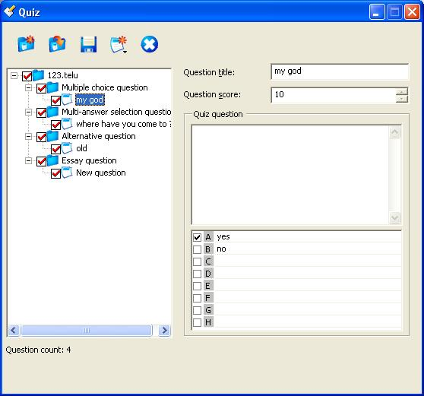
Operate Teacher Control
Quiz & Test – Prepare Quiz Paper
Create the examination questions
Create a new test
Open a test
Save the test
Delete the test
Note: Choose or not is meaningless in Prepare Quiz Paper Mode.

Slide 20
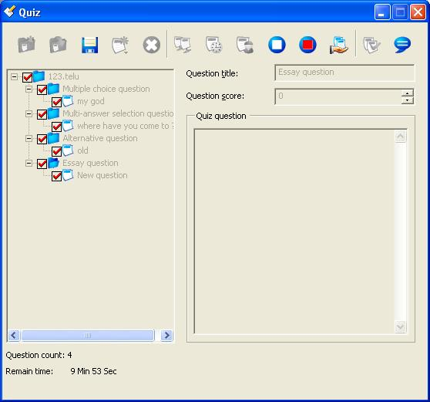
Operate Teacher Control
Quiz & Test – Start Test Paper
Send test and set the test time
Begin the test
Pop Question
Create the examination questions
Suspend test
Create a new test
Send Message
Open a test
Look the result of this test
Save the test
Stop Test and Collect quiz result
Delete the test
Stop the test actively
Note: Only the questions marked with will be sent to the students.

Slide 21
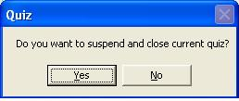
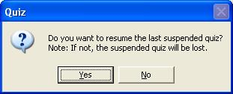
Operate Teacher Control
Quiz & Test – Suspend Test
If you want to suspend test, you could press the “Suspend” button, and there would Pop-up a dialog, press “Yes” to suspend the test. Refer to the Figure – suspend.
If there is suspended test, when you start the test again and there will pop-up a dialog , press “Yes” to continue the test that suspended. Refer to the Figure – continue.
Suspend test
Figure - suspend
Figure - continue
Quiz & Test Finished

Slide 22
Proposal to Lam Dong moving to 1PC:1student
Obstacles:
    Constrained state budget
    Basics ICT for teachers not available
  Proposal
    Accomplish 1:1 through various ways: State budget, parent buy, NGOs
    State: DOETs can propose to govt as part of stimulus program…buy 50-100 CMPC for every K-12 schools in Lam Dong
    Nguyen Hoang to support installment payment for CMPC for parents. Intel & Nguyen Hoang support 0% interests.
    LOEMs like FPT and Nguyen Hoang support teacher laptop program
    Intel supports 20 roadshows and seminars throughout Lam Dong to do in-depth training in partnership with Lam Dong DOET.

